Slide 1
ONLINE BACKUP SOFTWARE
Presented by:
HARISH. B

Slide 2
MOTIVE
The ultimate motive to come up with this project is being an software companies or any industries, the data's are more important than the people voice.
It is the way to keep an additional storage of the important document which they get deleted by unknowingly.
This software helps you to backup your information separately which you can surf the data’s easier even though it gets deleted.
This software helps you to backup your information and can be easily retrieved.
It reduces the pressure of human when the file gets deleted.
With the help of this software, the files can be easily recovered.

Slide 3
GOALS
Online backup, also known as Cloud backup or remote backup, is a strategy for sending a copy of a physical or virtual file or database to a secondary, off-site location for preservation in case of equipment failure.
The secondary server and data storage systems are usually hosted by a third-party service provider, who charges the backup customer a fee based on storage space or capacity used, data transmission bandwidth, number of users, number of servers or number of times data is accessed.
Implementing cloud data backup can help increase an organization's data protection strategy without increasing the workload of information technology (IT) staff.
The labor-saving benefit may be significant and enough of a consideration to offset some of the additional costs associated with cloud backup, such as data transmission charges.
Most cloud subscriptions run on a monthly or yearly basis. While initially used mainly by consumers and home offices, online backup services are now commonly used by small and medium-sized businesses (SMBs) as well as larger enterprises to back up some forms of data.

Slide 4
For larger companies, cloud data backup may serve as a supplementary form of backup.
A remote, online, or managed backup service, sometimes marketed as cloud backup or backup-as-a-service, is a service that provides users with a system for the backup, storage, and recovery of computer files.
Online backup providers are companies that provide this type of service to end users (or clients). Such backup services are considered a form of cloud computing.
Online backup systems are typically built for a client software program that runs on a given schedule.
Some systems run once a day, usually at night while computers aren't in use. Other newer cloud backup services run continuously to capture changes to user systems nearly in real-time.
The online backup system typically collects, compresses, encrypts, and transfers the data to the remote backup service provider's servers or off-site hardware

Slide 5
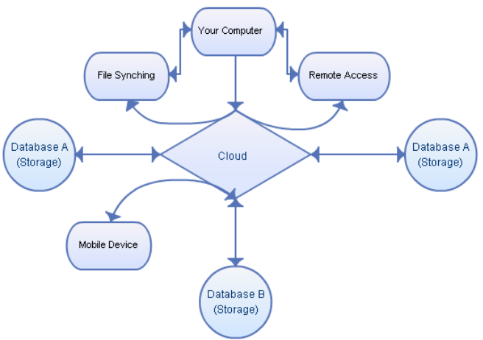
FLOWCHART

Slide 6
PROCESS
In an organization's data center, a backup application copies data and stores it on different media or another storage system for easy access in the event of a recovery situation.
While there are multiple options and approaches to off-site backup, cloud backup serves as the off-site facility for many organizations.
In an enterprise, the company might own the off-site server if it hosts its own cloud service, but the chargeback method would be similar if the company uses a service provider to manage the cloud backup environment.
While the amount of steps may vary based on backup method or type, this is the basic process involved with cloud backup, also known as online backup or remote backup.
There are a variety of approaches to cloud backup, with available services that can easily fit into an organization's existing data protection process.

Slide 7
Varieties of cloud backup include:
Backing Up Directly To The Public Cloud:
One way to store organizational workloads is by duplicating resources in the public cloud. This method entails writing data directly to cloud providers, such as AWS or Microsoft Azure.
The organization uses its own backup software to create the data copy to send to the cloud storage service.
The cloud storage service then provides the destination and safekeeping for the data, but it does not specifically provide a backup application.
In this scenario, it is important that the backup software is capable of interfacing with the cloud's storage service.
Backing Up To A Service Provider:
In this scenario, an organization writes data to a cloud service provider that offers backup services in a managed data center.
The backup software that the company uses to send its data to the service may be provided as part of the service, or the service may support specific commercially-available backup applications.

Slide 8
Choosing A Cloud-To-Cloud Backup:
These services are among the newest offerings in the cloud backup arena.
They specialize in backing up data that already lives in the cloud, either as data created using a software as a service application or as data stored in a cloud backup service.
As its name suggests, a cloud-to-cloud backup service copies data from one cloud to another cloud.
The cloud-to-cloud backup service typically hosts the software that handles this process.
Using Online Cloud Backup Systems:
There are also hardware alternatives that facilitate backing up data to a cloud backup service.
These appliances are all-in-one backup machines that include backup software and disk capacity along with the backup server.
The appliances are about as close to plug-and-play as backup gets, and most of them also provide a seamless (or nearly so) link to one or more cloud backup services or cloud providers.

Slide 9
The list of vendors that offer backup appliances that include cloud interfaces is long, with Quantum, Unit rends, Arc serve, Rubric, Cohesity, Dell EMC, Storage Craft and Asigra active in this arena.
These appliances typically retain the most recent backup locally, in addition to shipping it to the cloud backup provider, so that any required recoveries can be made from the local backup copy, saving time and transmission costs.

Slide 10
ADVANTAGES
Affordable:
Small businesses don’t have unlimited IT budgets. It’s important to use a solution that makes sense and won’t require your customer to incur a capital expenditure. For as low as a few hundred dollars per year, your customers can have all of their data backed up to the cloud.
Anytime, Anywhere Access:
Having data in the cloud allows your customers to have access to their data anytime and anywhere. As long as there is access to the Internet, through a computer or a smartphone app, all files are readily available. There is no need to have to travel around with a laptop or go back to the office to see that important file.
Off-Site:
It’s important to keep a copy of files offsite. Even if business files are backed up on a file server, a hurricane, flood, fire or theft could destroy the computers… and backups. Keeping backed up files in the cloud ensures data is safe no matter what is going on at your office.
Simple:
Cloud backup solutions have made ongoing management and restoration easy. With just a few clicks of the mouse, backed up files can be easily found and restored.

Slide 11
Removes user intervention & manual steps:
Online backup doesn’t require someone to change tapes over or label and store multiple CDs or memory sticks. Online backup removes that user intervention or other manual steps; saving time and money.
Automatic Backups:
Online backup records changes at each subsequent backup, in accordance with an automated schedule you have chosen. The process comes with built-in ‘retry’ to account for any possible disruptions; unlike the unreliability of human error or hardware or software faults of traditional backup methods. Some remote backup services will work continuously, backing up files as they are changed.

Slide 12
Thank you

